Slide 1

BENVENUTI

Slide 2
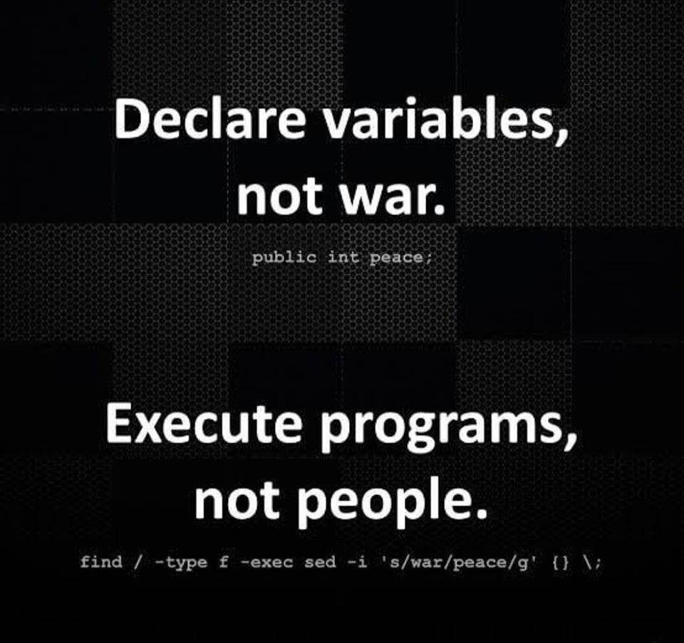

Slide 3
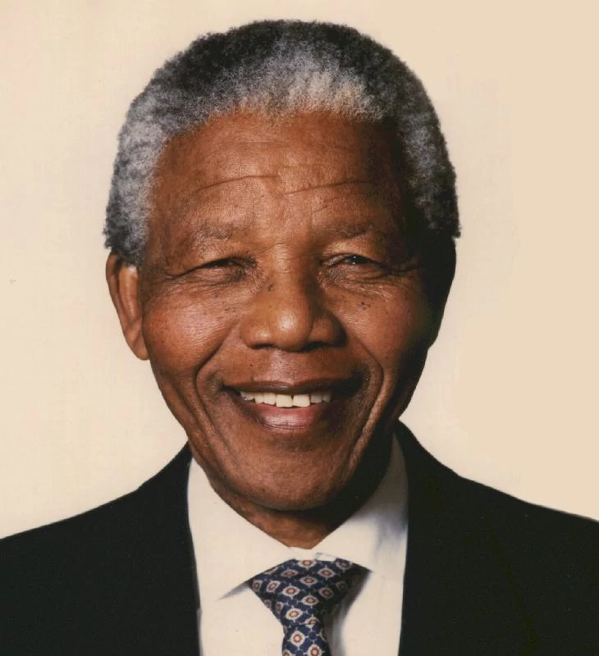

Nelson Mandela offers you a glass of water

Slide 4

This guy offers you a glass of water

Slide 5
People decide what is good and what is bad, basing on trust
Perception is influenced by trust

Slide 6


What frigthens you more?
It’s much more likely you die because of an heart attack than eaten by a shark

Slide 7
For security experts, security is Reality measured with probability and risks
For users security is just a feeling
A security expert should influence this feeling (good luck!)

Slide 8
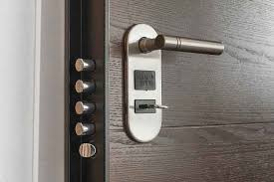
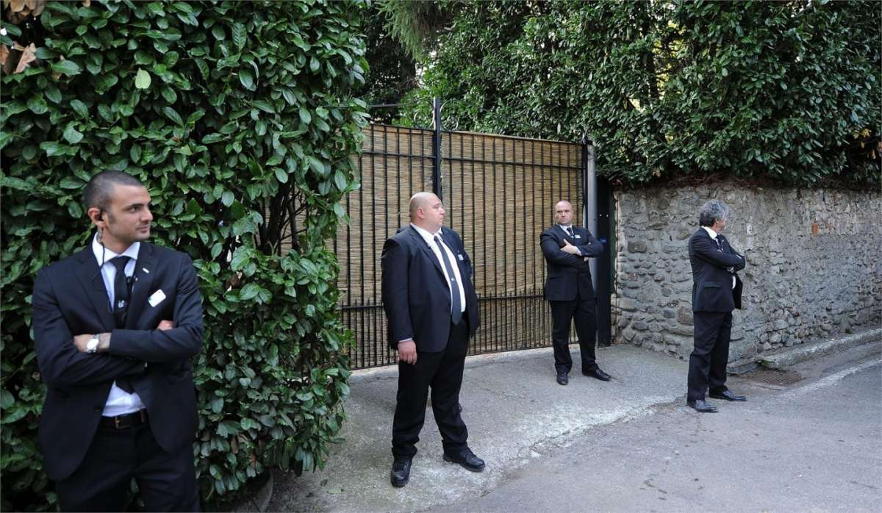
The feeling influences the expense

Slide 9

Security is a perception rather than a measurable goal (cit. me)

Slide 10
How d’you say cybersecurity in Italian?
Sicurezza cibernetica?
cibernetica
ci·ber·nè·ti·ca/
sostantivo femminile
Ramo della scienza pura e applicata, che si prefigge lo studio e la realizzazione di dispositivi e macchine capaci di simulare le funzioni del cervello umano, autoregolandosi per mezzo di segnali di comando e di controllo in circuiti elettrici ed elettronici o in sistemi meccanici.

Slide 11
How d’you say cybersecurity in Italian?
Sicurezza informatica e delle telecomunicazioni
Sicurezza delle reti e dei sistemi software
Sicurezza dei dispositivi con capacità computazionali e comunicative

Slide 12


Where does «Cyber» come from?
Cyberpunk
Originally forged by Bruce Bethke
as the title of a novel (1983),
Cyberpunk became suddenly a stream of science fiction, namely cyber-fantasy, and analyses the relationship between humans and computer science
William Gibson is the most famous representative of this literary stream, with his notorious novel «Neuromancer», 1984

Slide 13
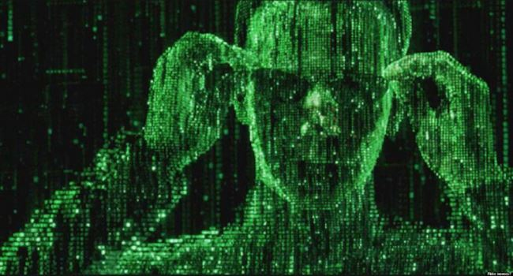
Now, we should talk abour Cyber-physical space
The Matrix, USA, 1999, Lana e Lilly Wachowski

Slide 14
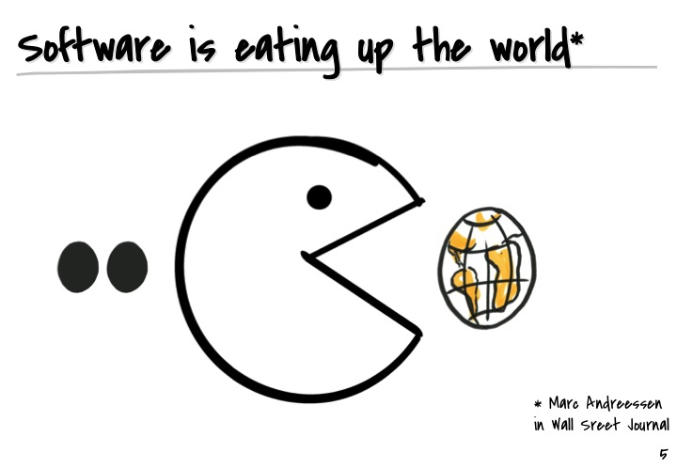
Why Cyber-Security is important?

Slide 15
The two players of the comedy
Cyber Attacker/Offender: who performs an attack to a system for elaborating, storing, or exchanging data.
Cyber Defender: who is in charge of protecting a system for elaborating, storing, or exchanging data from an attack.
Asset: the object of defense
Physical level
Logical level
Hacker: this is another thing….

Slide 16
The advantage of the Attacker
The attacker knows when, what, where will be attacked (from).
The attacker wins if wins 1 time
The defender loses if loses 1 time

Slide 17
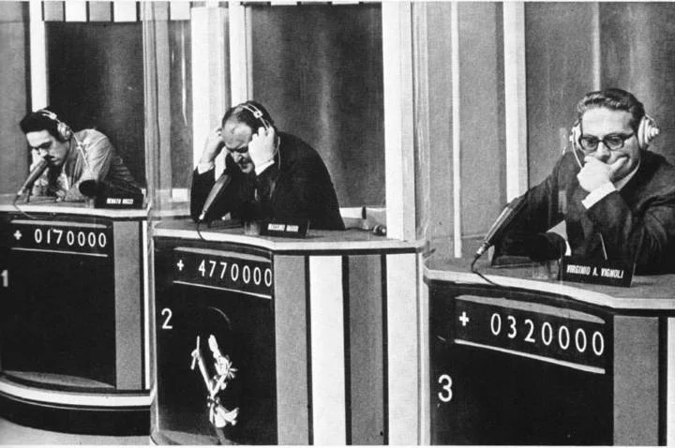
Does security affect the quality of software?

Slide 18


Slide 19


Slide 20
ISO/IEC 9126-1
Functionality - "A set of attributes that bear on the existence of a set of functions and their specified properties. The functions are those that satisfy stated or implied needs.”
Suitability
Accuracy
Interoperability
Security
Functionality compliance

Slide 21
Vulnerabilità vs bug
A bug is a defect due to an incomplete or incorrect specification
Bug discovery: to verify that the specification be complete and correct
A vulnerability is a defect that add an undesired and unexpected functionality to a system
Vulnerability discovery: to a functionality that is unknown

Slide 22
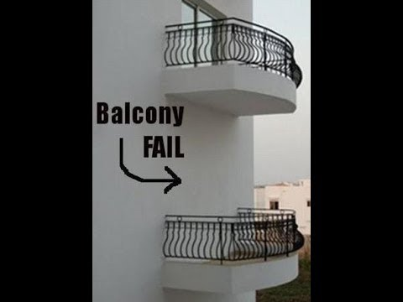

Bug
Vulnerability

Slide 23

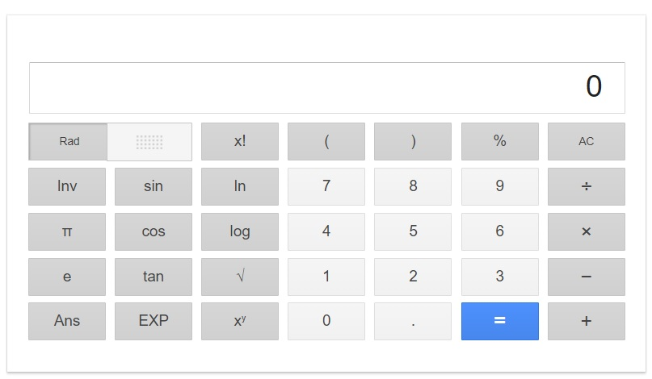
Esempio
1. Trova un bug
2. Trova una vulnerabilità

Slide 24
Bug Fixing vs Vulnerability Fixing
(Studio presentato alla International Conference on Software Engineering)

Slide 25
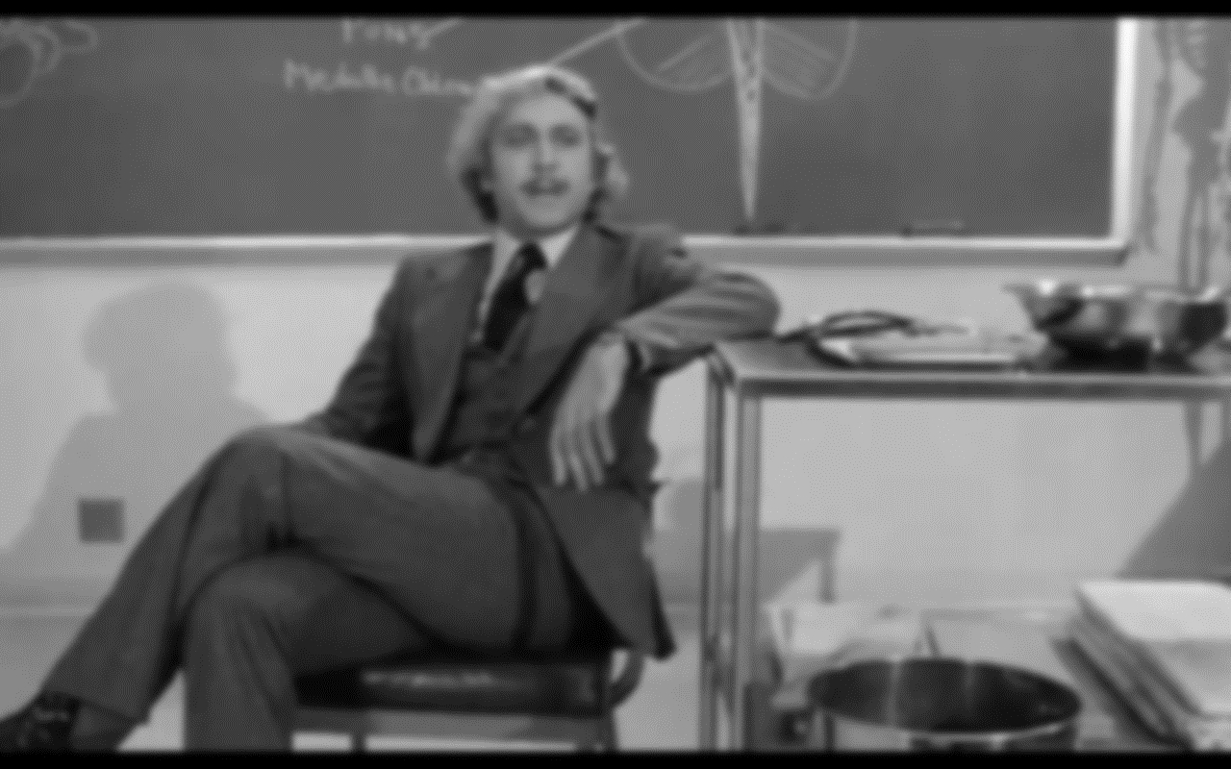
3 Critical Areas (at least)
Security by design, secure/defensive programming
quali competenze disponibili?
Come costruirle?
Standard
sovrapposti
copertura incompleta
Vulnerability Management
compatibile con un processo di manutenzione ed evoluzione strutturato?

Slide 26
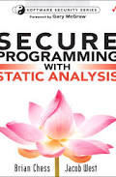
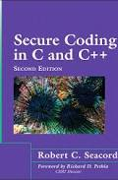
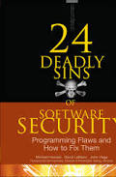

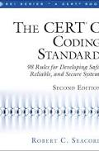
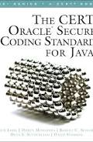

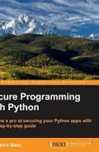
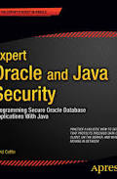
Security by design / secure code: le competenze
Non ci sono competenze diffuse tra gli attuali programmatori
Non ci sono centri di formazione sufficienti e sufficientemente completi in questa disciplina
Non c’è la cultura della security by design
Cosa è un’architettura sicura?
Come si scrive un test per la sicurezza?
Come si valuta la sicurezza di un sistema?
Come si definisce una baseline per la sicurezza di un sistema?

Slide 27

Esempio: la sql injection
String custname = request.getParameter("customerName");
// This should REALLY be validated too
// perform input validation to detect attacks
String query = "SELECT account_balance FROM user_data WHERE user_name = ? ";
PreparedStatement pstmt = connection.prepareStatement( query );
pstmt.setString( 1, custname);
ResultSet results = pstmt.executeQuery( );
Prepared Statement
Business Logic
String custname = request.getParameter("customerName");
// This should REALLY be validated try
{ CallableStatement cs = connection.prepareCall("{call sp_getAccountBalance(?)}");
cs.setString(1, custname); ResultSet results = cs.executeQuery();
// … result set handling } catch (SQLException se) {
// … logging and error handling
}
Stored Procedure
Data Layer
String tableName;
switch(PARAM): case "Value1": tableName = "fooTable";
break;
case "Value2": tableName = "barTable"; break;
... default : throw new InputValidationException("unexpected value provided for table name");
White List Input Validation
User Interface

Slide 28
Security changes the Maintenance process and the development process
Security by design
Proper tests for security (we have not oracles!!!!)
New kinds of tests
Vulnerability assessment
Penetration testing
Code assessment

Slide 29
Il problema degli standard
ISO/IEC 27001
ISO/IEC 27005
Software Assurance Maturity Model (SAMML)
Systems Security Engineering Capability Maturity Model (SEE-CMM)
Building Security In Maturity Model (BSIMM)
Secure Software Development Life Cycle (SSDLC)
OWASP

Slide 30
Specifica dei requisiti
Descrivere gli attacchi, Misuse Case, Abuse Case
AsmLSec, UML state charts
Descrivere i requisiti di sicurezza
UMLsec, Secure Tropos, SecureUML
Attack specification languages
STATL, snort rules
UMLsec
fair exchange (non barare tra le parti),
non-repudiation (un'azione non si può negare),
role-based access control,
secure communication link,
confidentiality,
integrity,
authenticity,
freshness of a message (ad esempio nonce),
secure information flow among components,
guarded access (uso di protezioni per imporre il controllo di accesso)
Secure UML
Politiche di controllo degli accessi
OCL based
Misuse case
Comportamenti indesiderati
Relazioni potenziali tra use case e misuse case
UMLIntr
Specifico per le intrusioni

Slide 31
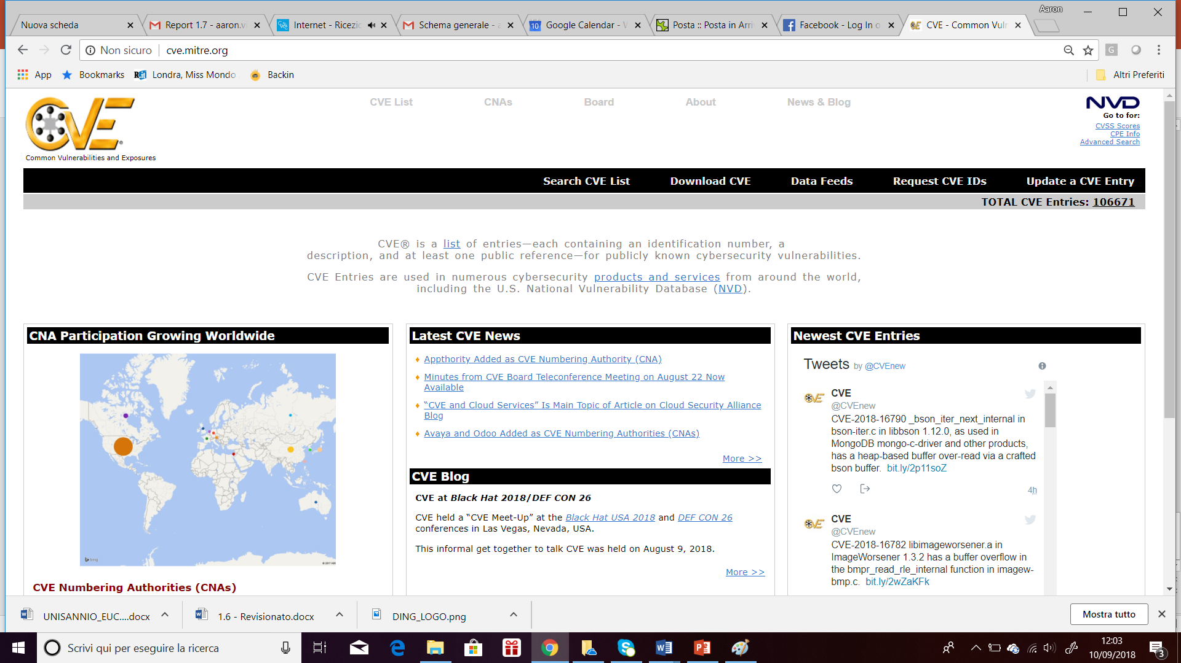
Vulnerability Management

Slide 32
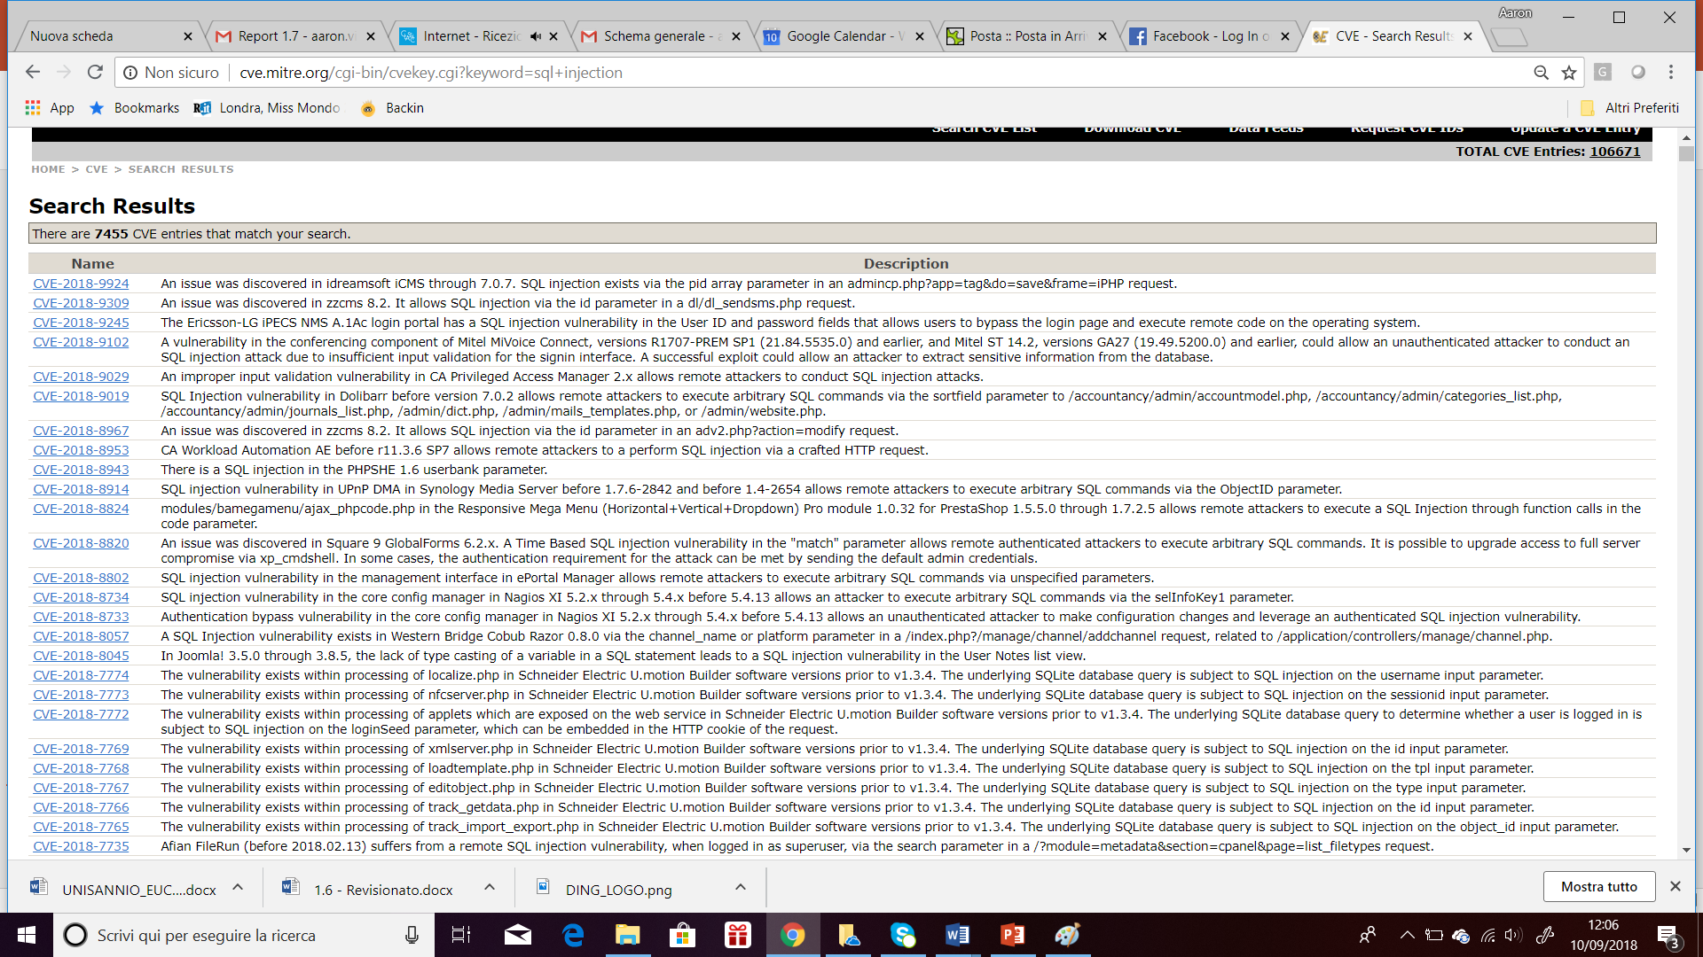
Let’s search for SQL Injection

Slide 33

Vulnerability fixing is not for kids
Asset management
Retrocompatibilità
Impatto sul sistema
Tempestività
Copertura completa sul sistema, sulle versioni, sulle linee di prodotto
Code Assessment (computer-aided)
Vulnerability Assessment
Penetration Testing
What about Zero day?

Slide 34

H-Factor: our main adversary
THE USER

Slide 35
H-Factor: our main adversary
Root or jailbreak our devices
Ports left open on servers
Privileges assignation
Preservation of credentials
How is our IT envirnoment secure when doing (sensitive) things
What about privacy protection?

Slide 36

Technology is important, but humans be much more
Notes:
Aircrafts increased their technology, but training of pilots did not decrease.
You choose an hospital for the equipement they have or for the equipes they have?

Slide 37

User’s awareness
Compliance
Functionality
Usability
However, I have the antivirus!
Interoperability
Policies
Zero Day
APT
Performances
Costs
Regulations
Security Engineer

Slide 38
Security Life Cycle…
Governance
Upgrade
Planning
Incident Response
Operation
Monitoring

Slide 39
...Security Life Cycle…
Governance
Managing
Training
Budgeting
Planning
Risk Analysis
Threat Modelling
Competence mapping
Operation
Controls Deployment and maintenance
Asset management

Slide 40
…Security Life Cycle
Monitoring
Check IOC
Vulnerability Assessment
Penetration Testing
Incident Response
Detect incident
React to incident
Damages inventory
Restore Operation
Upgrade
Improve Security levels

Slide 41
Security Scope
Networks
Developed software (source code)
Acquired software
Appliances
Data & Information Protection
Access Management
BYOD
Human Factor / Social Engineering

Slide 42






What CyberSecurity is
DESIGN
GOVERNANCE
CODING
BEHAVIOUR
V&V
SETTINGS

Slide 43
Security Decision Making
Security Responsibilities
Third party (pentest, assessment, network design & maintenance, network administration)
Clerances
Real access & accounting
& Much more

Slide 44

(Hacking)

Slide 45
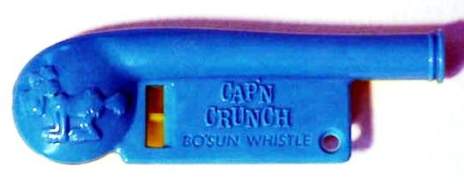
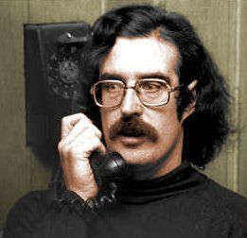

Notes:
John Draper

Slide 46

1960: Hacking begins in the 60s, mostly at MIT to bypass or improve operation of systems
1971: John Droper, aka Captain Crunch, invents the blue box, a method for doing free long distance phone calls with a whistle toy given away with Cap’n Crunch cereals
1972: Steve Wozniak and Steve Jobs learn the art of Phreaking, taking the name of Berkeley Blue (Woz) and Oaf Tobar (Jobs)

Slide 47
1981: Chaos Computer Club, the largest European Association of hackers is Founded.
1984: 2600 the first quaterly of hacking is published
1986: The Computer Abuse and Fraud Act is passed at the Congress
1988: Kevin Poulsen (Dark Dante) hacks a federal computer network, pursued by the police, ending in hiding

Slide 48
1988: Robert Morris developed the Morris Worm, the first Worm ever
1989: Robert Morris was the first convicted under the Computer Abuse and Fraud Act
1991: Kevin Poulsen is arrested by police and condemned to 5 years of prison
1994 Vladimir Levin stole around 10 Million $ from Citibank accounts
1995 Kevin Mitnick is arrested after 14 years long hunting – Vladimir Levin is caught: 3 years in prison.

Slide 49
2000 The ILOVEYOU worm spread in the web causing $10 billion of damages.
2000 Michael Calce (MafiaBoy) lauches a series of DDOS bringing down Yahoo!, eBay, CNN, Amazon and Dell.com in the space of a week
2001 Gary McKinnon(Solo) hack into 97 US military and NASA computers, allegedly disrupted operations, deleting files, and posting messages
2001 Michael Calce is arrested
2002 Gary McKinnon is arrested
2004 AOL staff member Jason Smathers steals the details of 92 millon customers, and sells them on to spammers
2007 George Hotz becomes the first person ever to carrier unlock the iPhone

Slide 50
2011: Hacker Group LulzSec hacks Sony repeatedly, stealing information from 70 million user accounts
2012: Visa and Mastercard are hacked: <1.5 Million customers have their credit cards stolen
2013: Syrian loyalists hack the Twitter account of Associated Press

Slide 51
Ukrainian Power Grid
23 Dicembre 2015: Hackers were able to successfully compromise information systems of three energy distribution companies in Ukraine and temporarily disrupt electricity supply to the end consumers
250.000 were left without electricity for a period from 1 to 6 hours
prior compromise of corporate networks using spear-phishing emails with BlackEnergy malware;
seizing SCADA under control, remotely switching substations off;
disabling/destroying IT infrastructure components (uninterruptible power supplies, modems, RTUs, commutators);
destruction of files stored on servers and workstations with the KillDisk malware;
denial-of-service attack on call-center to deny consumers up-to-date information on the blackout.

Slide 52
Stuxnet
Targets industrial computer systems and was responsible for causing substantial damage to Iran's nuclear program
Stuxnet specifically targets programmable logic controllers (PLCs), which allow the automation of electromechanical processes such as those used to control machinery on factory assembly lines, amusement rides, or centrifuges for separating nuclear material. Exploiting four zero-day flaws, Stuxnet functions by targeting machines using the Microsoft Windows operating system and networks, then seeking out Siemens Step7 software.
a worm that executes all routines related to the main payload of the attack; a link file that automatically executes the propagated copies of the worm; and a rootkit component responsible for hiding all malicious files and processes, preventing detection of the presence of Stuxnet.
It is typically introduced to the target environment via an infected USB flash drive
Stuxnet reportedly ruined almost one fifth of Iran's nuclear centrifuges.
the worm infected over 200,000 computers and caused 1,000 machines to physically degrade

Slide 53

Heartbleed is a security bug in the OpenSSL cryptography library
It was introduced into the software in 2012 and publicly disclosed in April 2014
As of May 20, 2014, 1.5% of the 800,000 most popular TLS-enabled websites were still vulnerable to Heartbleed

Slide 54
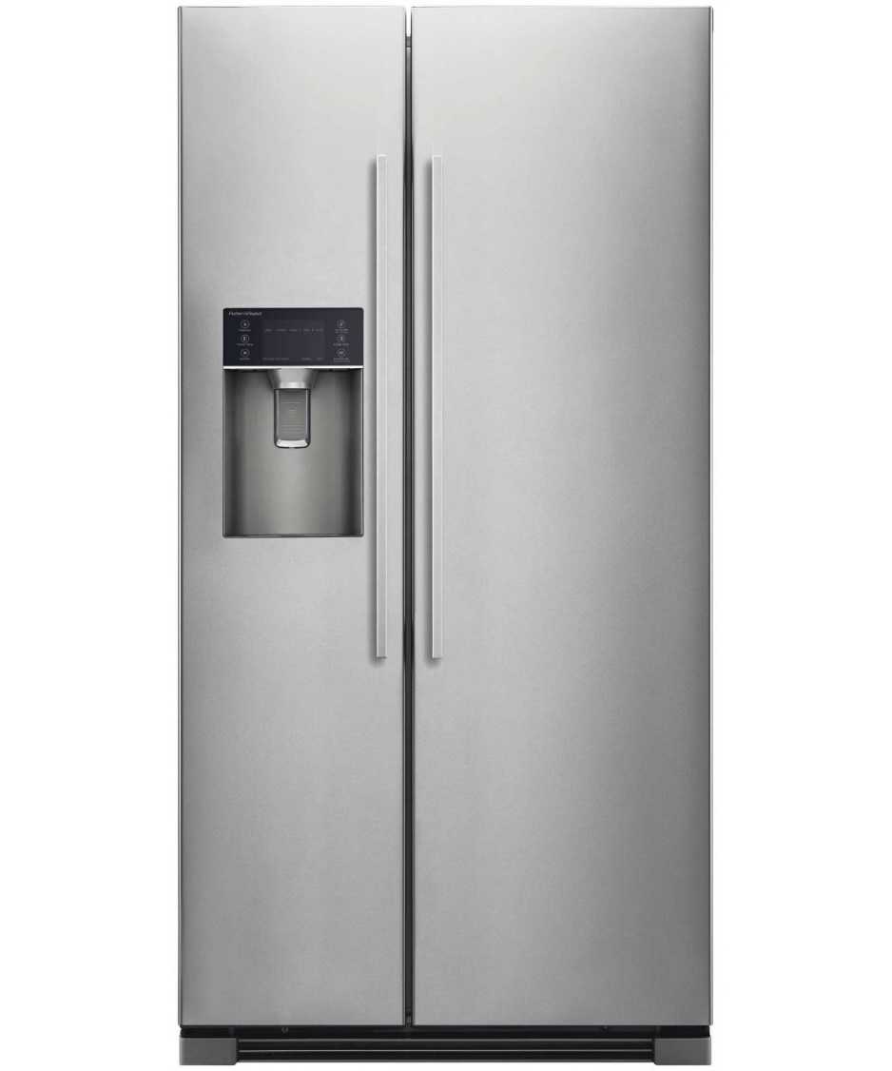

The Fridges’ War
The 2016 Dyn cyberattack took place on October 21, 2016, and involved multiple distributed denial-of-service attacks (DDoS attacks) targeting systems operated by Domain Name System (DNS) provider Dyn, which caused major Internet platforms and services to be unavailable to large swathes of users in Europe and North America.

Slide 55
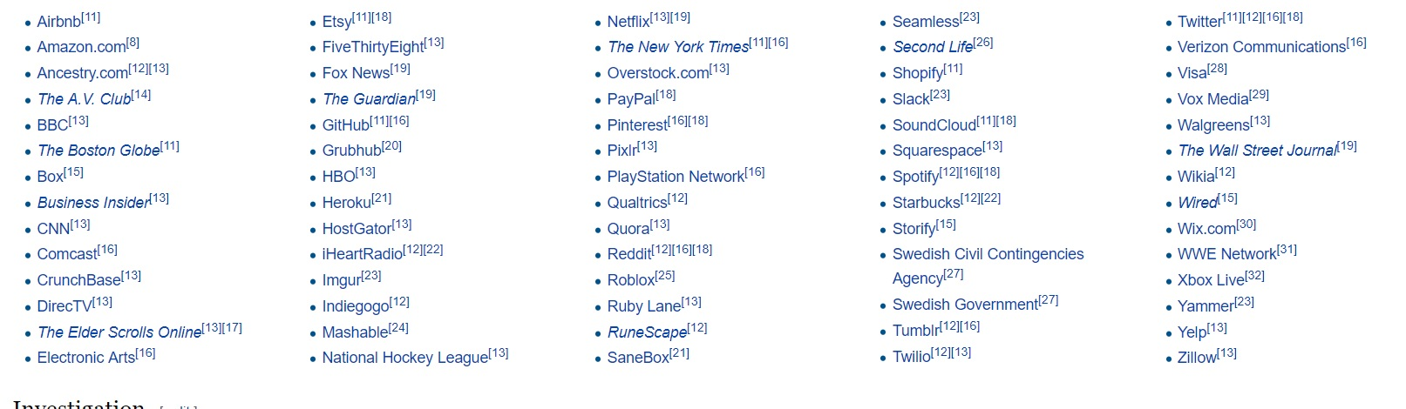

Slide 56




What you don’t need

Slide 57
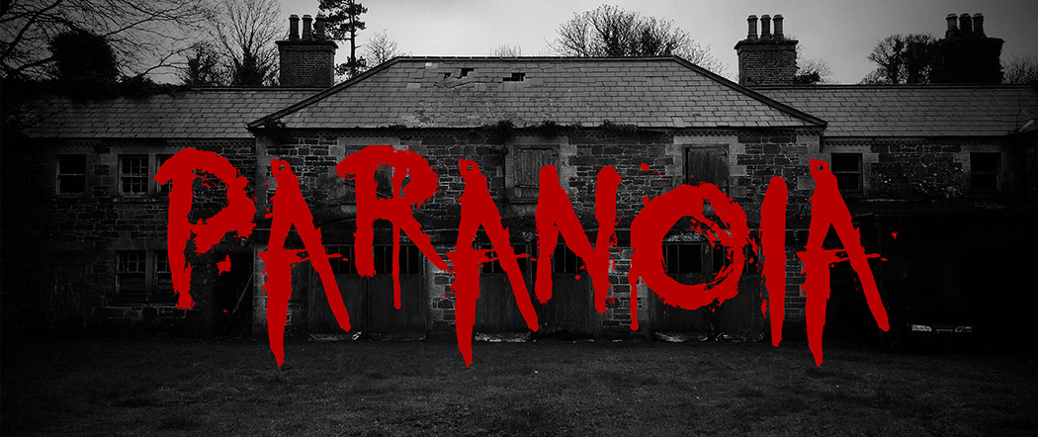
What you need is only

Slide 58


Why attacking is easier than defending?
Where?
Who?
How?
Where?

Slide 59
Who gains from attacks?
Market antagonists
State Nation sponsored stakeholders
Organized Crime
Lamers, Script kiddies
Your work mate/ your boss/ your employee
Tua suocera.

Slide 60



What you won’t become after this course

Slide 61

What –hopefully- you become after this course
An engineer aware of complexity of Information and Network Security –INS- field, with a great consciousness of how to get specialized and focused on a specific area of INS.

Slide 62
Goals
The goal of the course is to give students:
An overview of the realm of Networks and Software Security
The Engineering Approach to face Net/Softw Security
The main problems that a Security Engineer must cope with
Some operational tools to work with Info Sec

Slide 63
Syllabus
Blockchain
intrusion detection
DDOS
Network Security
Malware
BOTNET
Sistemi Operativi TRUSTED
DATABASE SECURITY
ANDROID SECURITY
CODE SECURITY
WEB SECURITY
CRITTOGRAFIA-BASE
CRITTOGRAFIA AVANZATA
AUTENTICAZIONE
CONTROLLO DEGLI ACCESSI
VA/PENTEST
SYSTEM EVALUATION
ASSURANCE
RISK ASSESSMENT & SECURITY TEST
PROGRAM SECURITY

Slide 64

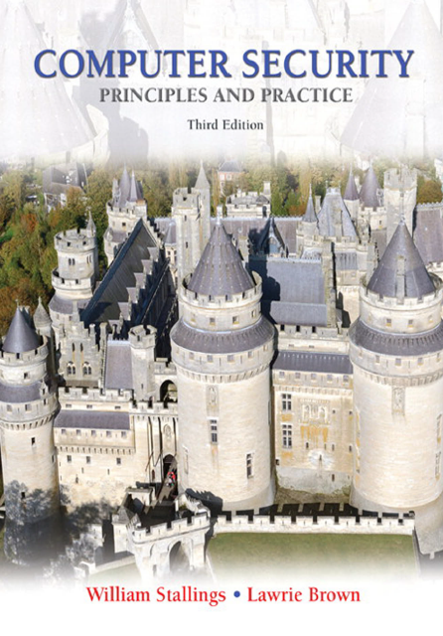
The Handbook

Slide 65
The Exam
Interview
Project Work
In october you will be provided with the topics

Slide 66
The week
2 hours theoretical
2 hours lab
2 hours project works (more later)

Slide 67
What I suggest to watch
Mr. Robot [2015], first Season
Millennium – Uomini che odiano le donne [2009]
Paranoia 1.0 [2004]
Wargames [1983]
I signori della truffa [1992]

Slide 68
What I suggest to read
Takedown: The Pursuit and Capture of Kevin Mitnick, America's Most Wanted Computer Outlaw - By the Man Who Did It, Tsutomo Shimomura, John Markoff, Mass Market, 1996
THE ART OF INTRUSION: The Real Stories Behind the Exploits of Hackers, Intruders and Deceivers, Kevin Mitnick with William L. Simon, John Wiley & Sons, 2005
Dark Territories, Fred Kaplan, Simon&Schuster, 2016,
Cybercrime: The Transformation of Crime in the Information Age, David S. Wall, 2007.

Slide 69
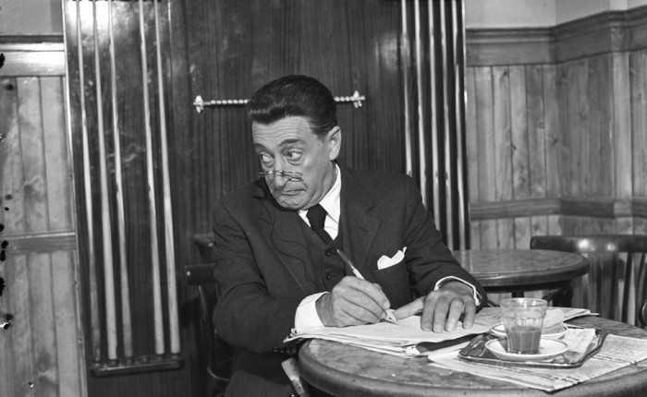
Grazie → Domande?
Contatti:
Corrado Aaron Visaggio
Dipartimento di Ingegneria
Universtià degli Studi del Sannio
visaggio@unisannio.it
aaron.visaggio@gmail.com
www.iswatlab.eu

Slide 70
Basic Components: Confidentiality
Confidentiality is the concealment of information or resources
Enforce the «need to know» principle
Access control mechanisms support confidentiality
Cryptography
Other access control mechanisms can protect access.
Confidentiality also applies to the existence of data, which is sometimes more revealing than the data itself
Access control mechanisms sometimes conceal the mere existence of data
Resource hiding is another important aspect of confidentiality

Slide 71
Basics Components: Integrity
Integrity refers to the trustworthiness of data or resources, and it is usually phrased in terms of preventing improper or unauthorized change.
Data integrity
Origin of the data ->authentication
Key role of credibility
Integrity mechanisms fall into two classes
Prevention mechanisms seek to maintain the integrity of the data by blocking any unauthorized attempts to change the data or any attempts to change the data in unauthorized ways
Detection mechanisms may analyze system events (user or system actions) to detect problems or (more commonly) may analyze the data itself to see if required or expected constraints still hold.
integrity includes both the correctness and the trustworthiness of the data

Slide 72
Basics Components: Availability
Availability refers to the ability to use the information or resource desired
System designs usually assume a statistical model to analyze expected patterns of use, and mechanisms ensure availability when that statistical model holds
Manipulate use for altering assumptions the statistics rely on.
denial of service attacks, can be the most difficult to detect, because the analyst must determine if the unusual access patterns are attributable to deliberate manipulation of resources or of environment

Slide 73
Threats…
A threat is a potential violation of security
Attacks are actions that violate security policies
Those who execute such actions are called attackers
Shirey divides threats into four broad classes:
disclosure, or unauthorized access to information;
deception, or acceptance of false data;
disruption, or interruption or prevention of correct operation;
and usurpation, or unauthorized control of some part of a system.

Slide 74
..Threats…
Snooping, the unauthorized interception of information
Wiretapping, or passive wiretapping, is a form of snooping in which a network is monitored.
Modification or alteration, an unauthorized change of information, covers three classes of threats.
Active wiretapping is a form of modification in which data moving across a network is altered (man in the middle)
Masquerading or spoofing, an impersonation of one entity by another, is a form of both deception and usurpation.
Some forms of masquerading may be allowed. Delegation occurs when one entity authorizes a second entity to perform functions on its behalf. The distinctions between delegation and masquerading are important

Slide 75
…Threats
Repudiation of origin, a false denial that an entity sent (or created) something, is a form of deception
A variant of this is denial by a user that he created specific information or entities such as files
Denial of receipt, a false denial that an entity received some information or message, is a form of deception
Delay, a temporary inhibition of a service, is a form of usurpation, although it can play a supporting role in deception
Denial of service, a long-term inhibition of service, is a form of usurpation, although it is often used with other mechanisms

Slide 76
Policy and mechanisms
A security policy is a statement of what is, and what is not, allowed
Without a security policy there cannot be a security breach!
A security mechanism is a method, tool, or procedure for enforcing a security policy
Mechanisms can be non-technical
Policies may be represented mathematically
If policies are inconsistent, either or both sites must decide what the security policy for the combined site should be.
The inconsistency often manifests itself as a security breach

Slide 77
Security Controls
define
Security Mechnisms
defines
Security Policies
Prevent/
Discover
define
Security Breaches
Done by
Attacker
Adversary

Slide 78
Goals of Security…
Given a security policy’s specification of “secure” and “nonsecure” actions, these security mechanisms can prevent the attack, detect the attack, or recover from the attack.
Prevention means that an attack will fail
Preventative mechanisms often are very cumbersome and interfere with system use to the point that they hinder normal use of the system
Detection is most useful when an attack cannot be prevented, but it can also indicate the effectiveness of preventative measures.
Detection mechanisms accept that an attack will occur
Detection mechanisms do not prevent compromise of parts of the system, which is a serious drawback.

Slide 79
…Goals of Security
Recovery has two forms.
to stop an attack and to assess and repair any damage caused by that attack
In some cases, retaliation (by attacking the attacker’s system or taking legal steps to hold the attacker accountable) is part of recovery.
the system continues to function correctly while an attack is under way.

Slide 80
Assumptions and Trust..
How do we determine if the policy correctly describes the required level and type of security for the site
a policy consists of a set of axioms that the policy makers believe can be enforced
Designers of policies always make two assumptions.
the policy correctly and unambiguously partitions the set of system states into “secure” and “nonsecure” states.
the security mechanisms prevent the system from entering a “nonsecure” state. If either assumption is erroneous, the system will be nonsecure.
Security mechanisms can be secure, precise and broad.
Let P be the set of all possible states.
Let Q be the set of secure states (as specified by the security
policy).
Let the security mechanisms restrict the system to some set of states R (thus,
R ⊆ P).

Slide 81
… Assumptions and Trust
Trusting that mechanisms work requires several assumptions.
Each mechanism is designed to implement one or more parts of the security policy.
The union of the mechanisms implements all aspects of the security policy.
The mechanisms are implemented correctly.
The mechanisms are installed and administered correctly.

Slide 82
Assurance
Assurance is an attempt to provide a basis for bolstering (or substantiating or specifying) how much one can trust a system
Detailed specifications of the desired (or undesirable) behavior;
an analysis of the design of the hardware, software, and
other components to show that the system will not violate the specifications; and
arguments or proofs that the implementation, operating procedures, and maintenance procedures will produce the desired behavior

Slide 83
Specification
A specification is a (formal or informal) statement of the desired functioning of the system
Mathematical
Informal
Low-level
The defining quality is a statement of what the system is allowed to do or what it is not allowed to do
Specifications are used not merely in security but also in systems designed for safety, such as medical technology

Slide 84
Design & Implementation…
The design of a system translates the specifications into components that will implement them.
The design is said to satisfy the specifications if, under all relevant circumstances, the design will not permit the system to violate those specifications.
Verification:
Mathematically
Mechanically

Slide 85
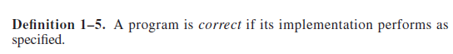
…Design & Implementation…
Given a design, the implementation creates a system that satisfies that design. If the design also satisfies the specifications, then by transitivity the implementation will also satisfy the specifications.
From the combination of routines, programs can be built and formally verified.
(-) complexity -> preconditions
(-) Programs compile correctly
(-) partial verification because of the rejecting of inputs

Slide 86
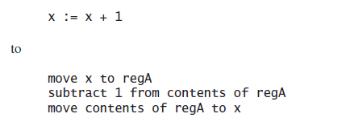
…Design & Implementation
Because formal proofs of correctness are so time-consuming, a posteriori verification techniques known as testing have become widespread
(-) they do not provide the same degree of assurance that formal methods do

Slide 87
Operational Issues: Cost-Benefit Analysis
If the data or resources cost less, or are of less value, than their protection, adding security mechanisms and procedures is not cost-effective because the data or resources can be reconstructed more cheaply than the protections themselves -> rare case
Adding security mechanisms to an existing system is often more expensive (and, incidentally, less effective) than designing them into the system in the first place.

Slide 88
Operational Issues: Risk Analysis
To determine whether an asset should be protected, and to what level, requires analysis of the potential threats against that asset and the likelihood that they will materialize.
The level of protection is a function of the probability of an attack occurring and the effects of the attack should it succeed
the risks change with time
many risks are quite remote but still exist
the problem of “analysis paralysis”
Notes:
the problem of “analysis paralysis” refers to making risk analyses
with no effort to act on those analyses.

Slide 89
Operational Issues: Law Analysis
Laws restrict the availability and use of technology and affect procedural controls.
Hence, any policy and any selection of mechanisms must take into account legal considerations
Society distinguishes between legal and acceptable practices
The issue that laws and customs raise is the issue of psychological acceptability
An unused mechanism is worse than a nonexistent one
Notes:
DNA SAMPLES

Slide 90
Operational Issues: Human Issues
Security provides no direct financial rewards to the user.
who is responsible for the security of the company’s computers
responsibility without power causes problems in any organization, just as does power without responsibility
clear chains of responsibility and power have been established
Lack of training
Lack of resources is another common problem

Slide 91
Operational Issues: People Problems
The heart of any security system is people
People who have some motive to attack an organization and are not authorized to use that organization’s systems are called outsiders and can pose a serious threat
a far more dangerous threat comes from disgruntled employees and other insiders who are authorized to use the computers
Untrained personnel
Lack of training need not be in the technical arena. Many successful break-ins have arisen from the art of social engineering

Slide 92
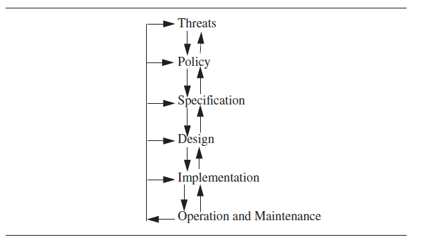
Tying It All Together

Slide 93
Access Control matrix

Slide 94
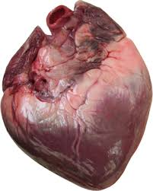
What is Access Control

Slide 95
What is Access Control
The ability to allow only authorized users, programs or processes system or resource access
The granting or denying, according to a particular security model, of certain permissions to access a resource
An entire set of procedures performed by hardware, software and administrators, to monitor access, identify users requesting access, record access attempts, and grant or deny access based on pre-established rules

Slide 96
Examples of Access Control
Facebook -> personal information
Web Browser -> cookies and other websites’ content
Operating System -> other user’s files / kill other user’s process
Memory Protection -> Intel 80x86 architecture, code in one region (for example, in Ring 3), cannot access the data in another more privileged region (e.g. Ring 0).
Firewalls -> protect networks from illicit accessing

Slide 97
Access Control Policy Models:
Discretionary Access Control (DAC)
Mandatory Access Control (MAC)
Access Control Mechanisms:
Access Control Matrices
Access Control List
Capability
Role-Based Access Control
Design Principles

Slide 98
Protection State…
The state of a system is the collection of the current values of all memory locations, all secondary storage, and all registers and other components of the system.
The subset of this collection that deals with protection is the protection state of the system.
An access control matrix is one tool that can describe the current protection state.
Consider the set of possible protection states P. Some subset Q of P consists of exactly those states in which the system is authorized to reside. So, whenever the system state is in Q, the system is secure. When the current state is in P – Q,1 the system is not secure.
Characterizing the states in Q is the function of a security policy;
Preventing the system from entering a state in P – Q is the function of a security mechanism

Slide 99
… Protection State
The access control matrix model characterizes the rights of each subject (active entity, such as a process) with respect to every other entity
The description of elements of A form a specification against which the current state can be compared
As the system changes, the protection state changes
When a command changes the state of the system, a state transition occurs.
A set of authorized states is defined, and then a set of operations is allowed on the elements of that set.
The result of transforming an authorized state with an operation allowed in that state is an authorized state

Slide 100
Access Control Matrix Model…
The simplest framework for describing a protection system is the access control matrix model, which describes the rights of users over files in a matrix
Butler Lampson first proposed this model in 1971; Graham and Denning refined it, and we will use their version.
The set of all protected entities (that is, entities that are relevant to the protection state of the system) is called the set of objects O.
The set of subjects S is the set of active objects, such as processes and users.
In the access control matrix model, the relationship between these entities is captured by a matrix A with rights drawn from a set of rights R in each entry a[s, o], where s ∈ S, o ∈ O, and a[s, o] ⊆ R.
The subject s has the set of rights a[s, o] over the object o. The set of protection states of the system is represented by the triple (S, O, A)
Disadvantage: in a large system may be enormous or sparse.

Slide 101
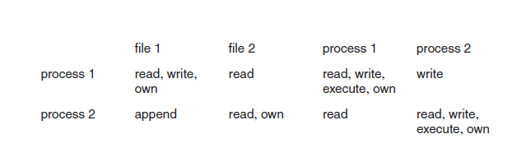
…Access Control Matrix Model…
Interpretation of the meaning of these rights varies from system to system. Reading from, writing to, and appending to files is usually clear enough, but what does “reading from” a process mean?
The meaning of the right may vary depending on the object involved.
The point is that the access control matrix model is an abstract model of the protection state.
The own right is a distinguished right. In most systems, the creator of an object has special privileges: the ability to add and delete rights for other users (and for the owner)

Slide 102
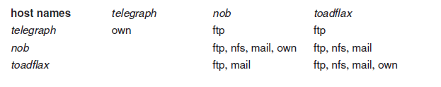
…Access Control Matrix Model…
Although the “objects” involved in the access control matrix are normally thought of as files, devices, and processes, they could just as easily be messages sent between processes, or indeed systems themselves
access control matrix for three systems on a local area network (LAN).
Notes:
Telegraph= pc + ftp cliet
Nob provides NFS service to clients but not to toasflax

Slide 103
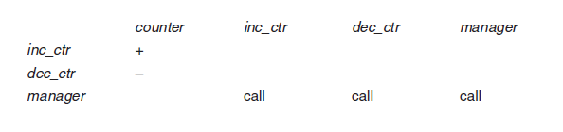
…Access Control Matrix Model…
At the micro level, access control matrices can model programming language accesses; in this case, the objects are the variables and the subjects are the procedures (or modules).

Slide 104
Access Control List
The column of access control matrix.
Pros:
Easy to determine who can access a given object.
Easy to revoke all access to an object
Cons:
Difficult to know the access right of a given subject.
Difficult to revoke a user’s right on all objects.
Used by most mainstream operating systems.

Slide 105
Capability List
The row of access control matrix
A capability can be thought of as a pair (x, r) where x is the name of an object and r is a set of privileges or rights.
Pros:
Easy to know the access right of a given subject.
Easy to revoke a users access right on all objects.
Cons:
Difficult to know who can access a given object.
Difficult to revoke all access rights to an object.
A number of capability-based computer systems were developed, but have not proven to be commercially successful.

Slide 106
Access Control List Examples

Slide 107
UNIX ACL
Abbreviations of Access Control Lists:
Three classes: owner, group, other users
Suffer from a loss of granularity
Full Access Control Lists

Slide 108
Windows NT
Generic rights: No access, Read, Change, Full control.
Built-in Groups (each has different privileges)
Everyone: all users
Interactive: users logged on locally
Network: users logged on over the network
System: the operating system
Creator / Owner: creator or owner of a file or a resource

Slide 109
Social networks
Most social networks use ACL as its main access control model. Users can specify who can access their profiles, friend lists, etc.

Slide 110
How is the ACL implemented in operating systems?
Where to store the access control list? (Must be in a safe place)
ACL is saved in the i-node data structure.
The i-node data structure

Slide 111
The i-node Data Structure in Minix

Slide 112
Reference Monitor
introduced in the Computer Security Technology Planning Study (Oct, 1972) by James Anderson & Co
The access mediation mechanism is always invoked every access is mediated. If this were not the case, then it would be possible for an entity to bypass the mechanism and violate the policy that must be enforced.
The access mediation mechanism is tamperproof. In the model, it is impossible for a penetrator to attack the access mediation mechanism such that the required access checks are not performed and authorizations not enforced.
It must be small enough to be subject to analysis and tests, the completeness of which can be assured. This must be the case, since if the mechanism could be demonstrated to be flawed, then it would not enforce the policy.

Slide 113
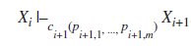
Protect State Transition…
As processes execute operations, the state of the protection system changes.
Let the initial state of the system be X₀ = (S₀, O₀, A₀). The set of state transitions is represented as a set of operations τ₁, τ₂, ....
Successive states are represented as X₁, X₂, ..., where the notation λ |–, and the expression
X_{i} |–_{τi+1}X_{i+1}
Series of transitions: X |–* Y
sequences of state transitions are represented as single commands, or transformation procedures, that update the access control matrix
let c_{k} be the kth command with formal parameters p_{k,1}, ..., p_{k,m}. Then the ith transition would be written as

Slide 114
…Protect State Transition…
Following Harrison, Ruzzo, and Ullman, we define a set of primitive commands that alter the access control matrix.
the protection state is (S, O, A) before the execution of each command and (S´, O´, A´) after each command
Primitive command: create subject s
Just modify the matrix, s doesn’t exist or o an object is executed before the command
Primitive command: create object o
Just modify the matrix, o must not exist before this command is executed
Primitive command: enter r into a[s, o]
adds the right r to the cell a[s, o].
Primitive command: delete r from a[s, o]
deletes the right r from the cell a[s, o].
Primitive command: destroy subject s
deletes the subject s
Primitive command: destroy object o
deletes the object o.

Slide 115
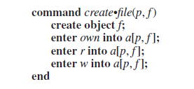
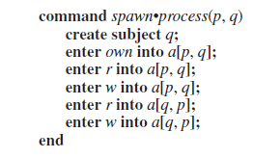
Examples
Process p created a file f with owner read (r) and write(w) permission
Process p created a new process q

Slide 116
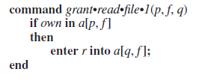
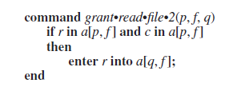
Conditional Commands…
Define preconditions: suppose a process p wishes to give another process q the right to read a file f. In some systems, p must own f
Suppose a system has the distinguished right c. If a subject has the rights r and c over an object, it may give any other subject r rights over that object

Slide 117
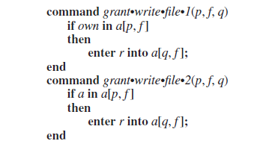
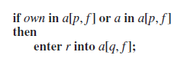
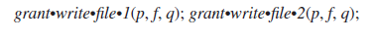
…Conditional Commands…
Commands with one condition are called monoconditional. Commands with two conditions are called biconditional.
Note that all conditions are joined by and, and never by or. Because joining conditions with or is equivalent to two commands each with one of the conditions, the disjunction is unnecessary and thus is omitted

Slide 118
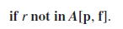
…Conditional Commands
Also, the negation of a condition is not permitted—that is, one cannot test for the absence of a right within a command by the condition

Slide 119
Foundational Results
Let R be the set of generic (primitive) rights of the system.
Definition 3–1. When a generic right r is added to an element of the access control matrix not already containing r, that right is said to be leaked.
Let a computer system begin in protection state S₀.
Definition 3–2. If a system can never leak the right r, the system (including the initial state s0) is called safe with respect to the right r. If the system can leak the right r (enter an unauthorized state), it is called unsafe with respect to the right r.
We use these terms rather than secure and nonsecure because safety refers to the abstract model and security refers to the actual implementation.
Thus, a secure system corresponds to a model safe with respect to all rights, but a model safe with respect to all rights does not ensure a secure system.
Notes:
Given a computer system, how can we determine if it is secure? More simply, is
there a generic algorithm that allows us to determine whether a computer system is
secure?
Our policy defines the authorized set of states A to be the set of states in which no command c(x1, ..., xn) can leak r. This means that no generic rights can be added
to the matrix.
We do not distinguish between the leaking of rights and an authorized transfer of rights. In our model, there is no authorized transfer of rights. (If we wish to allow such a transfer, we designate the subjects involved as “trusted.” We then eliminate all trusted subjects from the matrix, because the security mechanisms no longer apply to them.)

Slide 120
Basic results
The safety question: Does there exist an algorithm for determining whether a given protection system with initial state S₀ is safe with respect to a generic right r?
Theorem 3–1. There exists an algorithm that will determine whether a given mono-operational protection system with initial state S₀ is safe with respect to a generic right r.
Theorem 3–2. It is undecidable whether a given state of a given protection system is safe for a given generic right.

Slide 121
Security Policy

Slide 122
Definitions…
Consider a computer system to be a finite-state automaton with a set of transition functions that change state
Definition 4–1. A security policy is a statement that partitions the states of the system into a set of authorized, or secure, states and a set of unauthorized, or nonsecure, states.
Definition 4–2. A secure system is a system that starts in an authorized state and cannot enter an unauthorized state.
Definition 4–3. A breach of security occurs when a system enters an unauthorized state.
Definition 4–4. Let X be a set of entities and let I be some information. Then I has the property of confidentiality with respect to X if no member of X can obtain information about I.

Slide 123
.. Definitions…
Definition 4–5. Let X be a set of entities and let I be some information or a resource. Then I has the property of integrity with respect to X if all members of X trust I.
Definition 4–6. Let X be a set of entities and let I be a resource. Then I has the property of availability with respect to X if all members of X can access I.
security policy considers all relevant aspects of confidentiality, integrity, and availability
the illicit transmission of information without leakage of rights is called information flow
the policy must handle dynamic changes of authorization, so it includes a temporal element

Slide 124
…Definitions…
A security policy includes:
Integrity policy
Confidentiality policy
Availability policy
in many transactions, a principle called separation of duties forbids an entity from completing the transaction on its own
The statement of a security policy may formally state the desired properties of the system
In practice, a less formal type of security policy defines the set of authorized states.
The security policy then describes conduct, actions, and authorizations defining “authorized users” and “authorized use.”

Slide 125
…Definitions
Definition 4–7. A security mechanism is an entity or procedure that enforces some part of the security policy
Security policies are often implicit rather than explicit
The difference between a policy and an abstract description of that policy is crucial to the analysis that follows.
Definition 4–8. A security model is a model that represents a particular policy or set of policies.

Slide 126
Types of security Policies
Definition 4–9. A military security policy (also called a governmental security policy) is a security policy developed primarily to provide confidentiality.
Definition 4–10. A commercial security policy is a security policy developed primarily to provide integrity.
transaction-oriented integrity security policies, are critical to organizations that require consistency of databases
Confidentiality policies place no trust in objects
Integrity policies, to the contrary, indicate how much the object can be trusted
Definition 4–11. A confidentiality policy is a security policy dealing only with confidentiality.
Definition 4–12. An integrity policy is a security policy dealing only with integrity.

Slide 127
The Role of Trust
Assumptions are fairly high-level, but invalidating any of them makes a remediation a potential security problem.
The point is that any security policy, mechanism, or procedure is based on assumptions that, if incorrect, destroy the superstructure on which it is built
The patch:
came from the vendor and was not tampered with in transit
the vendor tested the patch thoroughly
the vendor’s test environment corresponds to her environment
the patch is installed correctly
Formal verification
The formal verification of S is correct
The assumptions made in the formal verification of S are correct
The program will be transformed into an executable whose actions correspond to those indicated by the source code
The hardware will execute the program as intended

Slide 128
Types of Access Control
Definition 4–13. If an individual user can set an access control mechanism to allow or deny access to an object, that mechanism is a discretionary access control (DAC), also called an identity-based access control (IBAC).
Identity is the key
Definition 4–14. When a system mechanism controls access to an object and an individual user cannot alter that access, the control is a mandatory access control (MAC), occasionally called a rule-based access control.
The role is the key, no matter which identiy
Definition 4–15. An originator controlled access control (ORCON or ORGCON) bases access on the creator of an object (or the information it contains).
The goal of this control is to allow the originator of the file (or of the information it contains) to control the dissemination of the information.

Slide 129
Confidentiality Policies
A confidentiality policy, also called an information flow policy, prevents the unauthorized disclosure of information
Unauthorized alteration of information is secondary
The term “governmental” covers several requirements that protect citizens’ privacy
The principle of “executive privilege” and the system of nonmilitary classifications suggest that the people working in the government need to limit the distribution of certain documents and information.

Slide 130
Bell-La Padula Model
The Bell-LaPadula Model corresponds to military-style classifications
The simplest type of confidentiality classification is a set of security clearances arranged in a linear (total) ordering.
These clearances represent sensitivity levels. The higher the security clearance, the more sensitive the information
A subject -> security clearance.
The goal of the Bell-LaPadula security model is to prevent read access to objects at a security classification higher than the subject’s clearance.
The Bell-LaPadula security model combines mandatory and discretionary access controls.

Slide 131
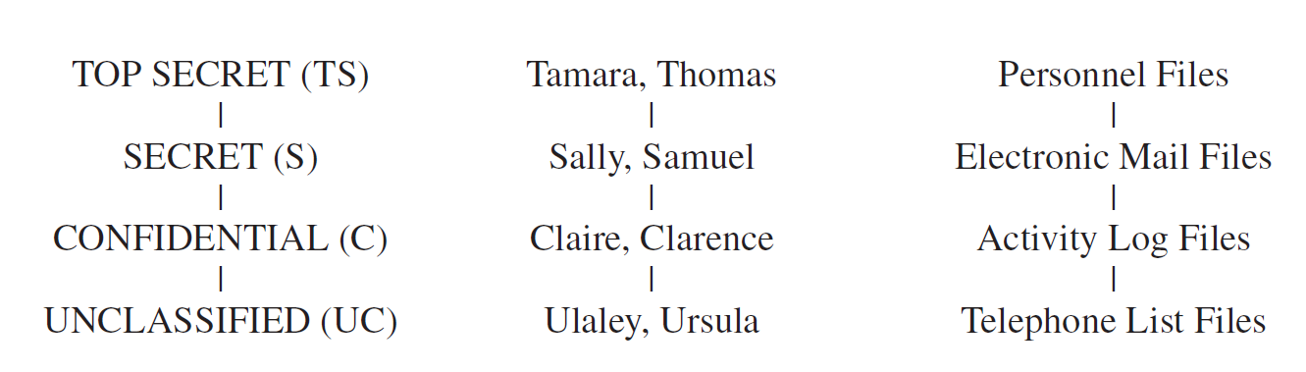
“S has discretionary read (write) access to O” means that the access control matrix entry for S and O corresponding to the discretionary access control component contains a read (write) right. In other words, were the mandatory controls not present, S would be able to read (write) O.

Slide 132
Let L(S) = ls be the security clearance of subject S, and let L(O) = lo be the security classification of object O. For all security classifications li, i = 0, ..., k – 1, li < li+1.
•Simple Security Condition, Preliminary Version: S can read O if and only if lo ≤ ls and S has discretionary read access to O.
*-Property (Star Property), Preliminary Version: S can write O if and only if ls ≤ lo and S has discretionary write access to O.
Define a secure system as one in which both the simple security condition, preliminary version, and the *-property, preliminary version, hold.

Slide 133
Theorem 5–1. Basic Security Theorem, Preliminary Version: Let Σ be a system with a secure initial state σ0, and let T be a set of state transformations. If every element of T preserves the simple security condition, preliminary version, and the *-property, preliminary version, then every state σi, i ≥ 0, is secure.
Expand the model by adding a set of categories to each security classification.
Each category describes a kind of information.
Categories arise from the «need to know» principle
no subject should be able to read objects unless reading them is necessary for that subject to perform its functions

Slide 134
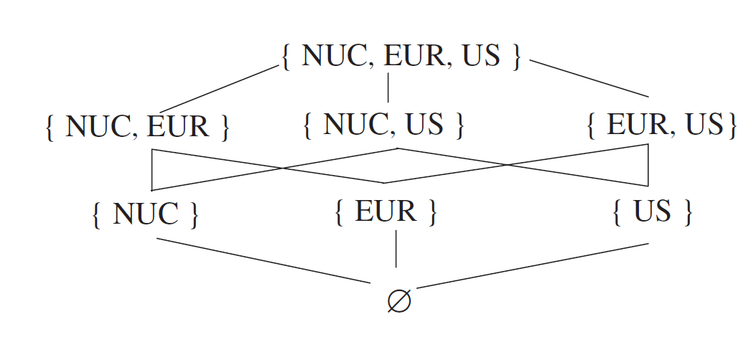
Security Level
Each security level and category form a security level
subjects have clearance at (or are cleared into, or are in) a security level and that objects are at the level of (or are in) a security level

Slide 135
Define the relation dom (dominates) as follows.
Definition 5–1. The security level (L, C) dominates the security level (L´, C´) if and only if L´ ≤ L and C´ ⊆ C.
We write (L, C) ￢dom (L´, C´) when (L, C) dom (L´, C´) is false
Simple Security Condition: S can read O if and only if S dom O and S has discretionary read access to O.
*-Property: S can write to O if and only if O dom S and S has discretionary write access to O
The simple security condition is often described as “no reads up” and the *-property as “no writes down.”

Slide 136
Redefine a secure system as one in which both the simple security property and the *-property hold
Theorem 5–2. Basic Security Theorem: Let Σ be a system with a secure initial state σ0, and let T be a set of state transformations. If every element of T preserves the simple security condition and the *-property, then every σi, i ≥ 0, is secure.
A subject has a maximum security level and a current security level. The maximum security level must dominate the current security level.
A subject may (effectively) decrease its security level from the maximum in order to communicate with entities at lower security levels.

Slide 137
Integrity Policies
Lipner identifies five requirements:
Users will not write their own programs, but will use existing production programs and databases.
Programmers will develop and test programs on a nonproduction system; if they need access to actual data, they will be given production data via a special process, but will use it on their development system.
A special process must be followed to install a program from the development system onto the production system.
The special process in requirement must be controlled and audited.
The managers and auditors must have access to both the system state and the system logs that are generated.
Notes:
Commercial requirement differ from military requirements

Slide 138
Priniciple
Separation of duty: if two or more steps are required to perform a critical function, at least two different people should perform the steps
Separation of function
Auditing: the process of analyzing systems to determine what actions took place and who performed them
Logging and auditing are especially important when programs move from the development system to the production system
the problem of information aggregation
Notes:
Depending on the sensitivity of the data, the developers and testers may receive sanitized production data. Further, the development environment must be as similar as possible to the actual production environment.

Slide 139
Biba integrity Model
In 1977, Biba studied the nature of the integrity of systems
A system consists of a set S of subjects, a set O of objects, and a set I of integrity levels.
The levels are ordered. The relation ≤ ⊆ I × I holds when the second integrity level either dominates or is the same as the first.
The function i:S ∪ O→I returns the integrity level of an object or a subject.
The higher the level:
more confidence the program will execute correctly
Data are more accurate/reliable
trustworthiness is used as a measure of integrity level

Slide 140
Definitions
Integrity labels are different from security labels.
Security labels limit the flow of information
Integrity labels limit the modification of information
Biba’s model is the dual of the Bell-LaPadula Model. Its rules are as follows.
s ∈ S can read o ∈ O if and only if i(s) ≤ i(o).
s ∈ S can write to o ∈ O if and only if i(o) ≤ i(s).
s1 ∈ S can execute s2 ∈ S if and only if i(s2) ≤ i(s1).
rules 1 and 2 imply that if both read and write are allowed, i(s) = i(o).
Notes:
by replacing the notion of “integrity level” with “integrity compartments,” and adding
the notion of discretionary controls, one obtains the full dual of Bell-LaPadula.
Pozzo and Gray [730, 731] implemented Biba’s strict integrity model on
the distributed operating system LOCUS [724]. Limit execution domains -> make explicit the level of trust of software
Credibility ratings->in the file system
Risk level associated to the user (tetto masssimo di credinblity rating dei programmi che potevano eseguire)

Slide 141
Clark-Wilson Integrity Model (1987)
Transactions are the basic elements -> commercial environments
The data is said to be in a consistent state (or consistent) if it satisfies given properties.
D + YB – W = TB
D= deposit
YB= all the accounts yesterday
W= today withdrrawn money
TB=all the money in the account today
A well-formed transaction is a series of operations that transition the system from one consistent state to another consistent state.
Integrity of transactions
Someone must certify that the transactions are implemented correctly.
The principle of separation of duty requires that the certifier and the implementors be different people.

Slide 142
The Model
The Clark-Wilson model defines data subject to its integrity controls as constrained data items, or CDIs.
Data not subject to the integrity controls are called unconstrained data items, or UDIs.
A set of integrity constraints (similar in spirit to the consistency constraints discussed above) constrain the values of the CDIs.
Procedures:
Integrity verification procedures, or IVPs, test that the CDIs conform to the integrity constraints at the time the IVPs are run-> the system is in a valid state
Transformation procedures, or TPs, change the state of the data in the system from one valid state to another; TPs implement well-formed transactions.

Slide 143
Rules…
Certification rule 1 (CR1): When any IVP is run, it must ensure that all CDIs are in a valid state.
Certification rule 2 (CR2): For some associated set of CDIs, a TP must transform those CDIs in a valid state into a (possibly different) valid state.
Enforcement rule 1 (ER1): The system must maintain the certified relations, and must ensure that only TPs certified to run on a CDI manipulate that CDI.
Enforcement rule 2 (ER2): The system must associate a user with each TP and set of CDIs. The TP may access those CDIs on behalf of the associated user. If the user is not associated with a particular TP and CDI, then the TP cannot access that CDI on behalf of that user.
This defines a set of triples (user, TP, { CDI set }) to capture the association of users, TPs, and CDIs. Call this relation allowed A.

Slide 144
…Rules…
Certification rule 3 (CR3): The allowed relations must meet the requirements imposed by the principle of separation of duty.
Enforcement rule 3 (ER3): The system must authenticate each user attempting to execute a TP.
Certification rule 4 (CR4): All TPs must append enough information to reconstruct the operation to an append-only CDI.

Slide 145
… Rules
Certification rule 5 (CR5): Any TP that takes as input a UDI may perform only valid transformations, or no transformations, for all possible values of the UDI. The transformation either rejects the UDI or transforms it into a CDI.
Enforcement rule 4 (ER4): Only the certifier of a TP may change the list of entities associated with that TP. No certifier of a TP, or of an entity associated with that TP, may ever have execute permission with respect to that entity.
Novel ideas:
Captures the way commercial firms work with data
Certification is distinct from enforcement
Notes:
An interesting observation is that the model does not require authentication
when a user logs into the system, because the user may manipulate only UDIs.

Slide 146
the Clark-Wilson model meets Lipner’s requirements.
Requirement 1. If users are not allowed to perform certifications of TPs, but instead only “trusted personnel” are, then CR5 and ER4 enforce this requirement. Because ordinary users cannot create certified TPs, they cannot write programs to access production databases. They must use existing TPs and CDIs—that is, production programs and production databases.

Slide 147
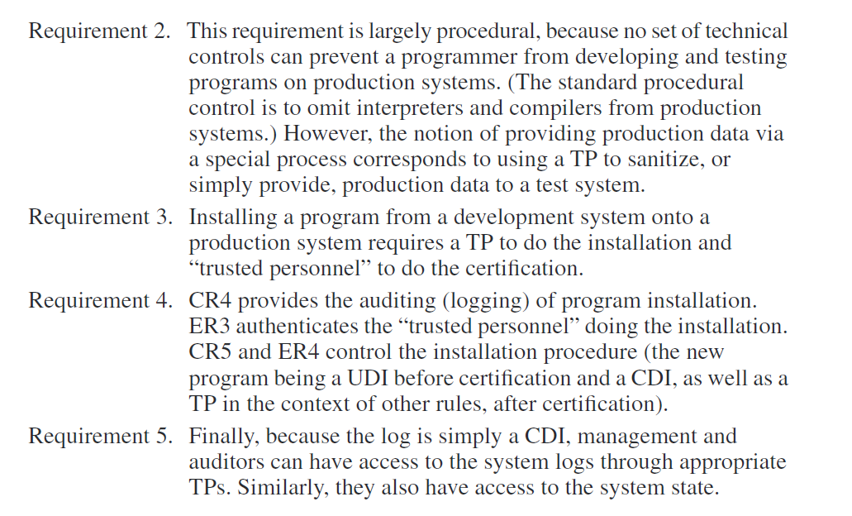

Slide 148
Comparison
Biba introduces the integrity levels->objects & subjects.
Clark-wilson Introduces integrity levels for objects and subjects.
The critical distinction between Biba and Clark-Wilson lies in the certification rules
Clark-Wilson is more practical than Biba
Clark-Wilson can emulate Biba.
Notes:
In the Biba model No mechanism or procedure is provided to verify the trusted entities or their actions.

Slide 149
Hybrid Policies

Slide 150
Chinese Wall Model
The Chinese Wall model is a model of a security policy that refers equally to confidentiality and integrity.
It describes policies that involve a conflict of interest in business, and is as important to those situations as the Bell-LaPadula Model is to the military.
Definition 7–1. The objects of the database are items of information related to a company.
Definition 7–2. A company dataset (CD) contains objects related to a single company.
Definition 7–3. A conflict of interest (COI) class contains the datasets of companies in competition.

Slide 151
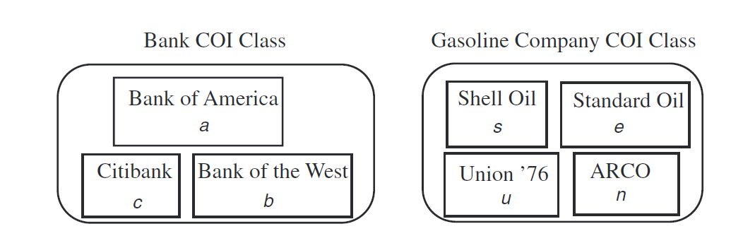
Let COI(O) represent the COI class that contains object O, and let CD(O) be the company dataset that contains object O. The model assumes that each object belongs to exactly one COI class.
Notes:
Anthony has access to the objects in the CD of Bank of America. Because the
CD of Citibank is in the same COI class as that of Bank of America, Anthony cannot
gain access to the objects in Citibank’s CD. Thus, this structure of the database provides
the required ability. (See Figure 7–1.)
This implies a temporal element. Suppose Anthony first worked on Bank of
America’s portfolio and was then transferred to Citibank’s portfolio. Even though he is
working only on one CD in the bank COI class at a time, much of the information he
learned from Bank of America’s portfolio will be current. Hence, he can guide Citibank’s investments using information about Bank of America—a conflict of interest

Slide 152
Let where PR(S) be the set of objects that S has read
CW-Simple Security Condition, Preliminary Version: S can read O if and only if either of the following is true.
There is an object O´ such that S has accessed O´ and CD(O´) = CD(O).
For all objects O´, O´ ∈ PR(S) ⇒ COI(O´) ≠ COI(O).
Initially, PR(S) = ∅, and the initial read request is assumed to be granted
Must distinguish between sanitized data and unsanitized data.
CW-Simple Security Condition: S can read O if and only if any of the
following holds.
There is an object O´ such that S has accessed O´ and CD(O´ ) = CD(O).
For all objects O´, O´ ∈ PR(S) ⇒ COI(O´) ≠ COI(O).
O is a sanitized object.
Notes:
Given
these assumptions, in the situation above, Bank of America’s COI class and
Citibank’s COI class are the same, so the second part of the CW-simple security condition
applies, and Anthony cannot access an object in the former, having already
accessed an object in the latter.
Two immediate consequences of this rule affect subject rights. First, once a
subject reads any object in a COI class, the only other objects in that COI class that
the subject can read are in the same CD as the read object. So, if Susan accesses
some information in Citibank’s CD, she cannot later access information in Bank of
America’s CD.
Second, the minimum number of subjects needed to access every object in a
COI class is the same as the number of CDs in that COI class. If the gasoline company
COI class has four CDs, then at least four analysts are needed to access all
information in the COI class. Thus, any trading house must have at least four analysts
to access all information in that COI class without creating a conflict of interest.

Slide 153
CW-*-Property: A subject S may write to an object O if and only if both of the following conditions hold.
The CW-simple security condition permits S to read O.
For all unsanitized objects O´, S can read O´ ⇒ CD(O´) = CD(O).

Slide 154
Bell-LaPadula and Chinese Wall Models
Subjects in the Chinese Wall model have no associated security labels, whereas subjects in the Bell-LaPadula Model do have such labels.
The Bell-LaPadula Model has no notion of “past accesses,” but this notion is central to the Chinese Wall model’s controls.
A second, more serious problem arises when one considers that subjects in the Chinese Wall model may choose which CDs to access; in other words, initially a subject is free to access all objects. The Chinese Wall model’s constraints grow as the subject accesses more objects. However, from the initial state, the Bell-LaPadula Model constrains the set of objects that a subject can access.
Hence, the Bell-LaPadula Model cannot emulate the Chinese Wall model faithfully. This demonstrates that the two policies are distinct.
However, the Chinese Wall model can emulate the Bell-LaPadula Model

Slide 155
Clark-Wilson and Chinese Wall Models
The Clark-Wilson model deals with many aspects of integrity, such as validation and verification, as well as access control
Because the Chinese Wall model deals exclusively with access control, it cannot emulate the Clark-Wilson model fully.
Because the Chinese Wall model would view processes independently of who was executing them, no constraints would be violated.
However, by requiring that a “subject” be a specific individual and including all processes executing on that subject’s behalf, the Chinese Wall model is consistent with the Clark-Wilson model.

Slide 156
Originator Controlled Access Control
Graubert developed a policy called ORGCON or ORCON (for “ORiginator CONtrolled”) in which a subject can give another subject rights to an object only with the approval of the creator of that object
Suppose a subject s ∈ S marks an object o ∈ O as ORCON on behalf of organization X.
Organization X allows o to be disclosed to subjects acting on behalf of a second organization, Y, subject to the following restrictions.
The object o cannot be released to subjects acting on behalf of other organizations without X’s permission.
Any copies of o must have the same restrictions placed on it.
Notes:
Discretionary access controls are insufficient for this purpose, because the owner
of an object can set any permissions desired. Thus, X cannot enforce condition (b).

Slide 157
Drawbacks
Mandatory access controls are theoretically sufficient for this purpose, but in practice have a serious drawback. Associate a separate category C containing o, X, and Y and nothing else.
If a subject y ∈ Y wishes to read o, x ∈ X makes a copy o´ of o. The copy o´ is in C, so unless z ∈ Z is also in category C, y cannot give z access to o´. This demonstrates adequacy.
A second problem with mandatory access controls arises from the abstraction.
Organizations that use categories grant access to individuals on a “need to know” basis.
The creation of categories to enforce ORCON implies local control of categories rather than central control, and a set of rules dictating who has access to each compartment.
ORCON abstracts none of this.
Notes:
Suppose a member w of an organization W wants to provide access to a document
d to members of organization Y, but the document is not to be shared with members
of organization X or Z. So, d cannot be in category C because if it were,
members x ∈ X and z ∈ Z could access d. Another category containing d, W, and Y
must be created. Multiplying this by several thousand possible relationships and documents
creates an unacceptably large number of categories.
ORCON is a decentralized system of access
control in which each originator determines who needs access to the data. No centralized
set of rules controls access to data; access is at the complete discretion of the
originator. Hence, the MAC representation of ORCON is not suitable.

Slide 158
A solution is to combine features of the MAC and DAC models. The rules are
The owner of an object cannot change the access controls of the object.
When an object is copied, the access control restrictions of that source are copied and bound to the target of the copy.
The creator (originator) can alter the access control restrictions on a per subject and per-object basis.
The critical observation here is that the access controls associated with the object are under the control of the originator and not the owner of the object
Notes:
The first two rules are from mandatory access controls. They say that the system controls
all accesses, and no one may alter the rules governing access to those objects.
The third rule is discretionary and gives the originator power to determine who can
access the object. Hence, this
Possession
equates to only some control. The owner of the object may determine to whom
he or she gives access, but only if the originator allows the access. The owner may
not override the originator.hybrid scheme is neither MAC nor DAC.

Slide 159
Role-Based Access Control
The ability, or need, to access information may depend on one’s job functions.
Definition 7–7. A role is a collection of job functions. Each role r is authorized to perform one or more transactions (actions in support of a job function).
The set of authorized transactions for r is written trans(r).
Definition 7–8. The active role of a subject s, written actr(s), is the role that s is currently performing.
Definition 7–9. The authorized roles of a subject s, written authr(s), is the set of roles that s is authorized to assume.
Definition 7–10. The predicate canexec(s, t) is true if and only if the subject s can execute the transaction t at the current time.
Three rules reflect the ability of a subject to execute a transaction.
Axiom 7–1. Let S be the set of subjects and T the set of transactions. The rule of role assignment is (∀s ∈ S)(∀t ∈ T)[ canexec(s, t) → actr(s) ≠ ∅ ].

Slide 160
Axiom 7–2. Let S be the set of subjects. Then the rule of role authorization is (∀s ∈ S)[ actr(s) ⊆ authr(s) ].
Axiom 7–3. Let S be the set of subjects and T the set of transactions. The rule of transaction authorization is (∀s ∈ S)(∀t ∈ T)[ canexec(s, t) → t ∈ trans(actr(s)) ].
The forms of these axioms restrict the transactions that can be performed.
They do not ensure that the allowed transactions can be executed. This suggests that role-based access control (RBAC) is a form of mandatory access control.
The axioms state rules that must be satisfied before a transaction can be executed.
Discretionary access control mechanisms may further restrict transactions.
Definition 7–11. Let r be a role, and let s be a subject such that r ∈ authr(s). Then the predicate meauth(r) (for mutually exclusive authorizations) is the set of roles that s cannot assume because of the separation of duty requirement.
Putting this definition together with the above example, the principle of separation of duty can be summarized as
(∀r1, r2 ∈ R) [ r2 ∈ meauth(r1) → [ (∀s ∈ S) [ r1 ∈ authr(s) → r2 ∉ authr(s) ] ] ]

Slide 161
